Slide 1
Greens on Screens Redesign
Section 1: Summary and evaluation Section 2: Analysis and Redesign
Section 3: Overcoming Issues identified

Slide 2
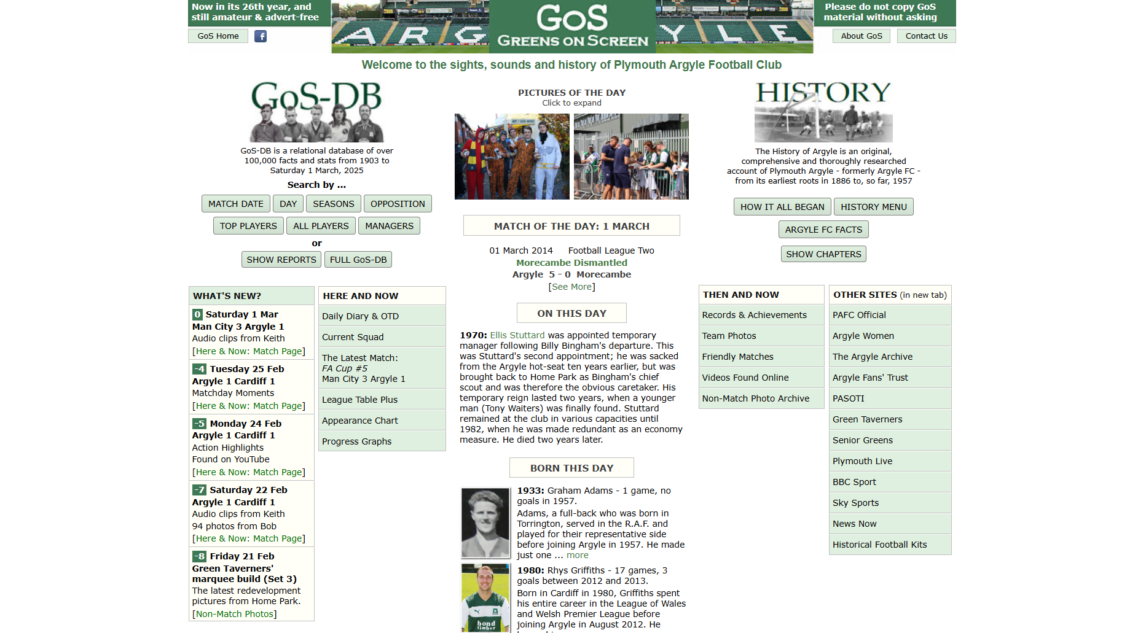
Greens on Screens Section 1: Summary
Notes:
Greens on screen is an amateur fan-based website describing the facts and stats of Plymouth argyle from 1903-Today

Slide 3
Greens on Screens Section 1: Target Audience
Currently 3400 followers on Facebook
Target audience appears to be fans
Plymouth argyle
Football
Plymouth
History

Slide 4
Greens on Screens Section 1: First Impressions
On This day
Latest news
Notes:
Greens on screen is an ameature fan-based website describing the facts and stats of Plymouth argyle from 1903-Today

Slide 5




Greens on Screens Section 1: User Goals
Look up Latest Results
Look up Future Fixtures
Look up Club Updates
Look up Player Appearances
Look at Green on screens On This Day posts
Connect fanbase Community
Look up Season Performance
Look up Current Squad
Look up Seasons performances
Look up Consecutive Appearances
Look up Current And Former Players
Look up Opposition History
Look up Managers
Look up Consecutive Results
Look up Attendance Highs and Lows
Look up Top Substitutes
Look up Youngest and Oldest players
Look up Season’s Best and Worst Starts
Look up Football League by Decade
Look up Football League by Calendar Year
Look up Success Rankings by Opposition
Look up Goal scorers by Season
Look up League Table
Look up Score Counts
Look up History articles
Team photos
Look up Friendly matches
Look up Argyle Videos
Look up Non-Match photo archive
Engage with other PAFC websites
Discover latest news & results
Find team stats and facts
Delve into Argyle's history
Connect with other Argyle fans
Notes:
I’ve found 30 user goals and summarised them in 4 main categories

Slide 6
Greens on Screens Section 1: Main interactions
Look up top players based on rankings
Look at latest updates
Find about section
Look at what happened on this day
Search a given player

Slide 7
Greens on Screens Section 1: Survey creation process
Mock evaluation process
Survey creation process
Find button or interaction
Evaluate result to perception
Perceive button or interaction result
Task scenarios
Mock evaluation
Identify Issues
Guide survey creation

Slide 8
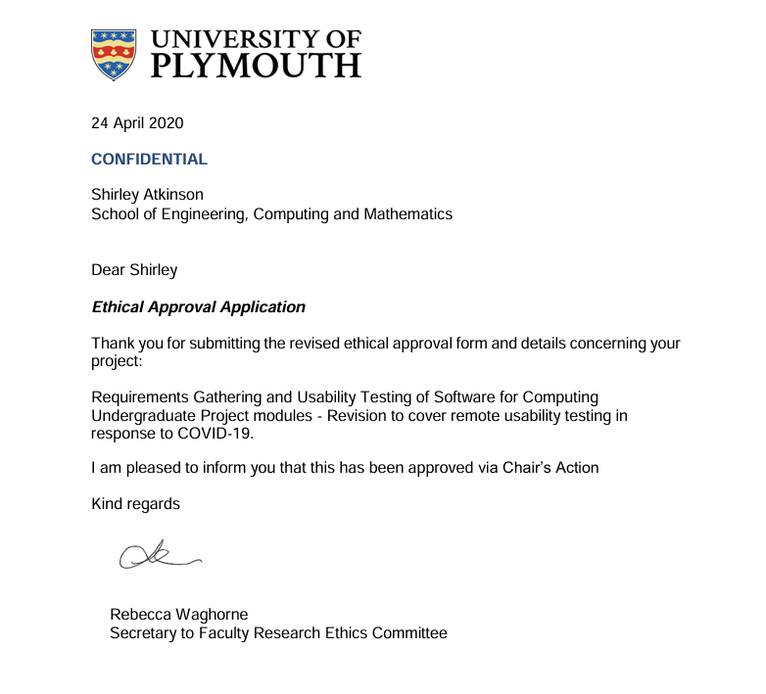
Greens on Screens Section 1: Documentation
University of Plymouth Ethics Approval

Slide 9
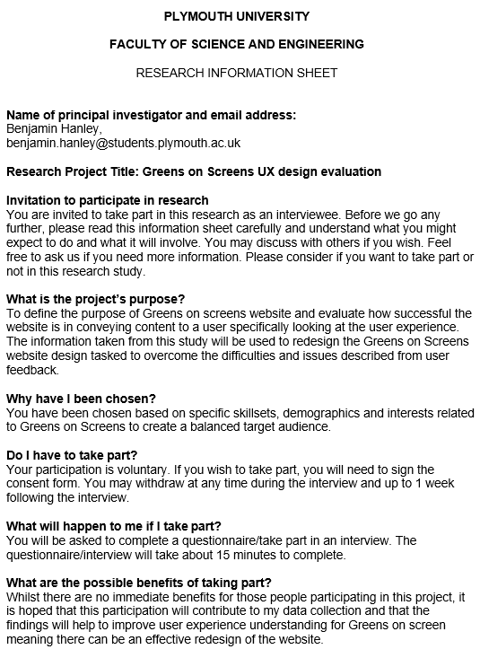
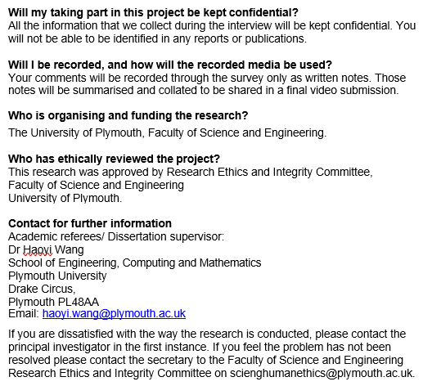
Greens on Screens Section 1: Documentation
Research Information Sheet

Slide 10
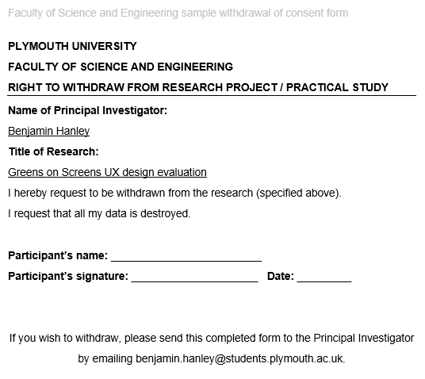
Greens on Screens Section 1: Documentation
Right to Withdraw form

Slide 11
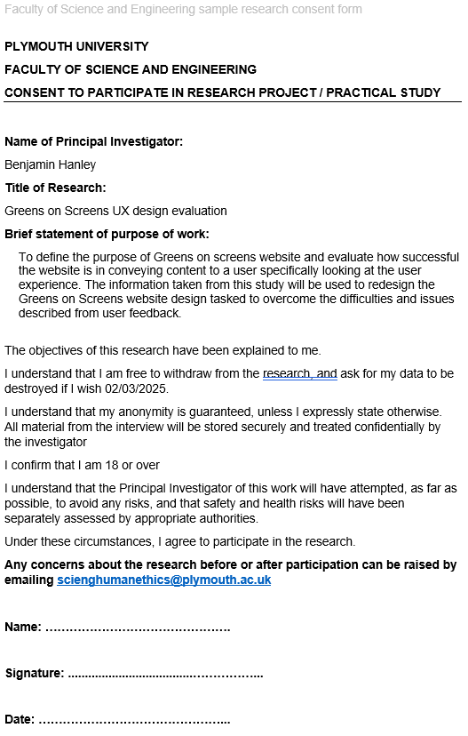
Greens on Screens Section 1: Documentation
Faculty ethics consent form

Slide 12
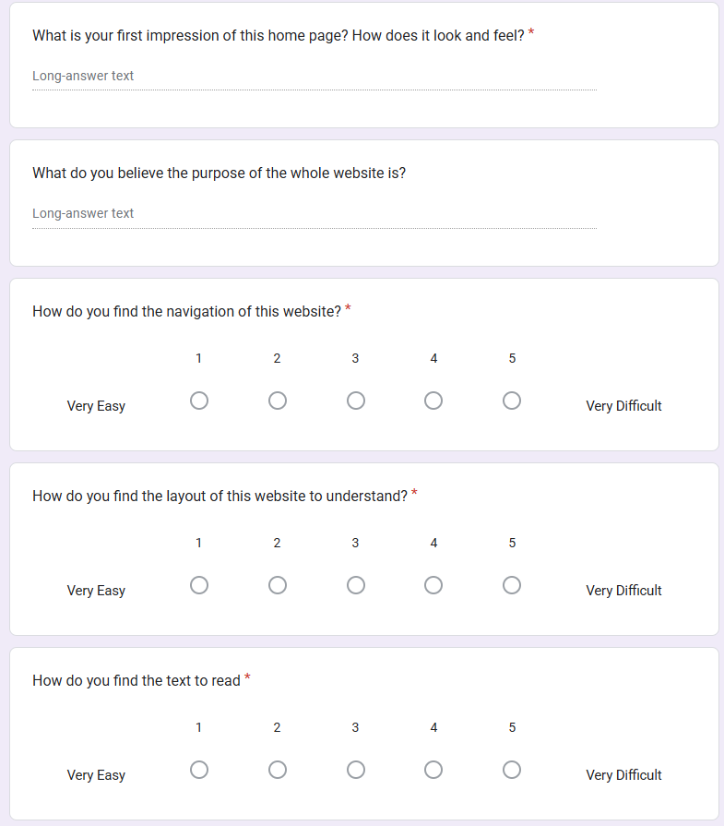
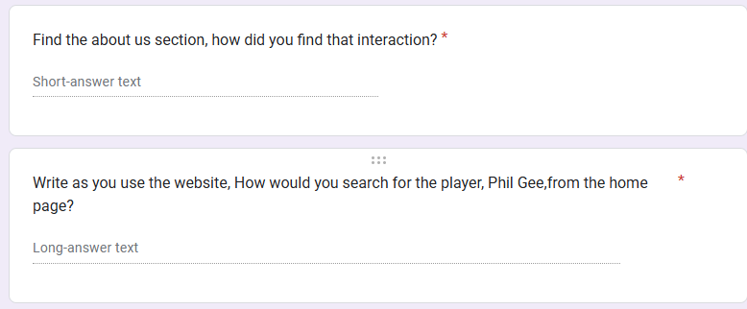
Greens on Screens Section 1: Survey

Slide 13
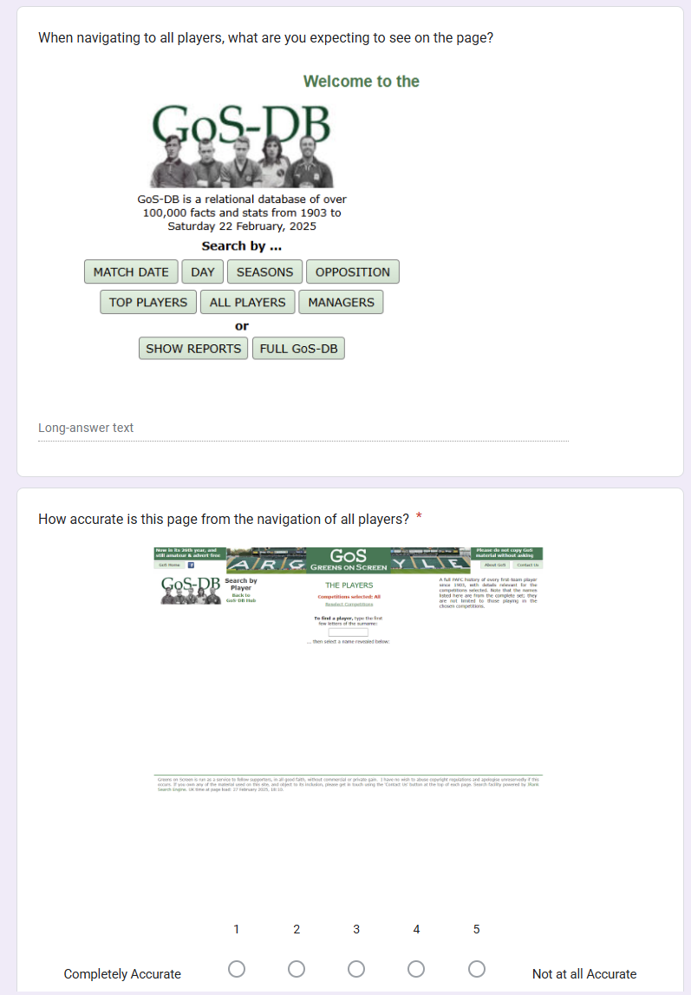
Greens on Screens Section 1: Survey

Slide 14
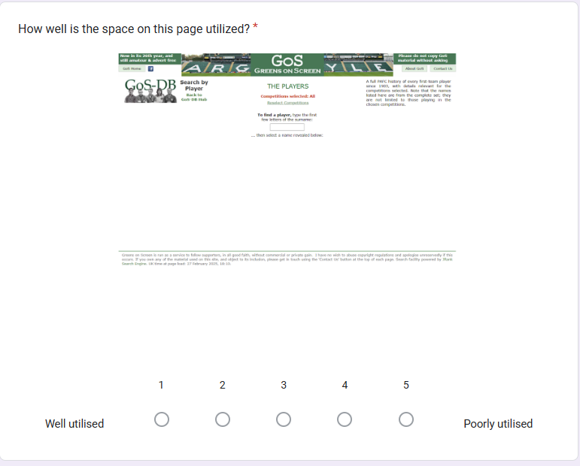
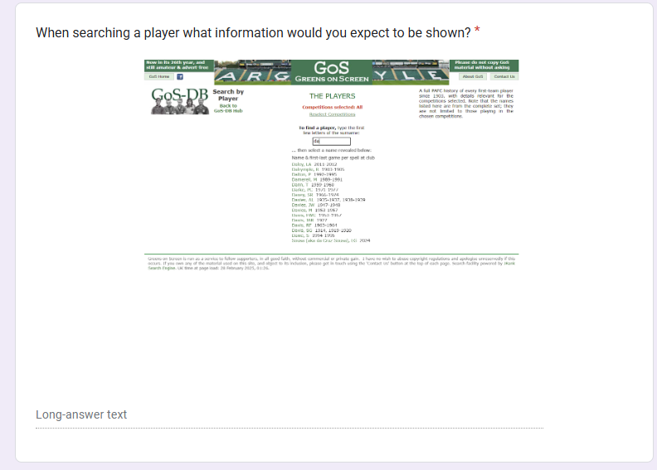
Greens on Screens Section 1: Survey

Slide 15
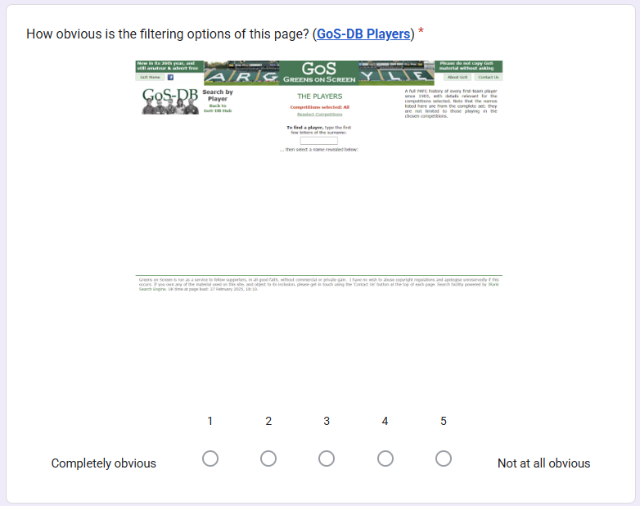
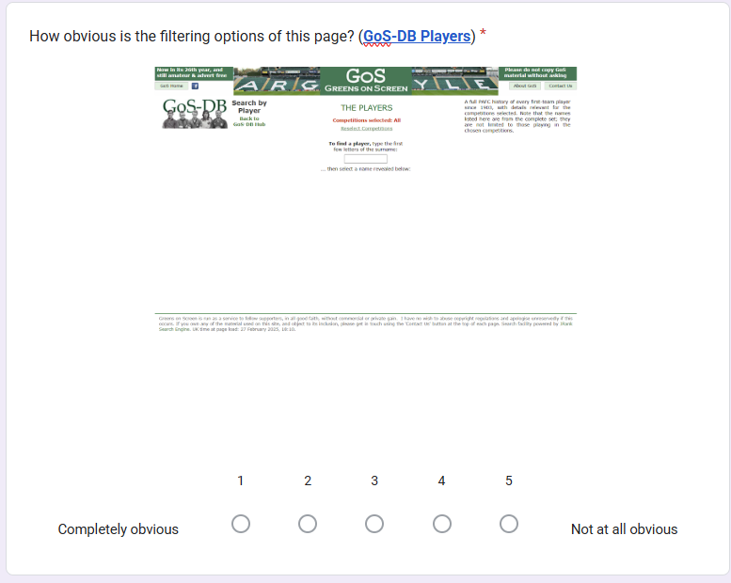
Greens on Screens Section 1: Survey

Slide 16
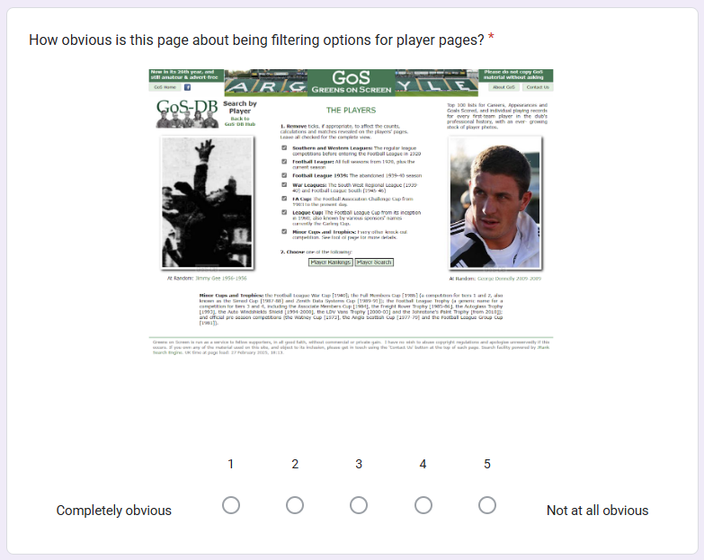
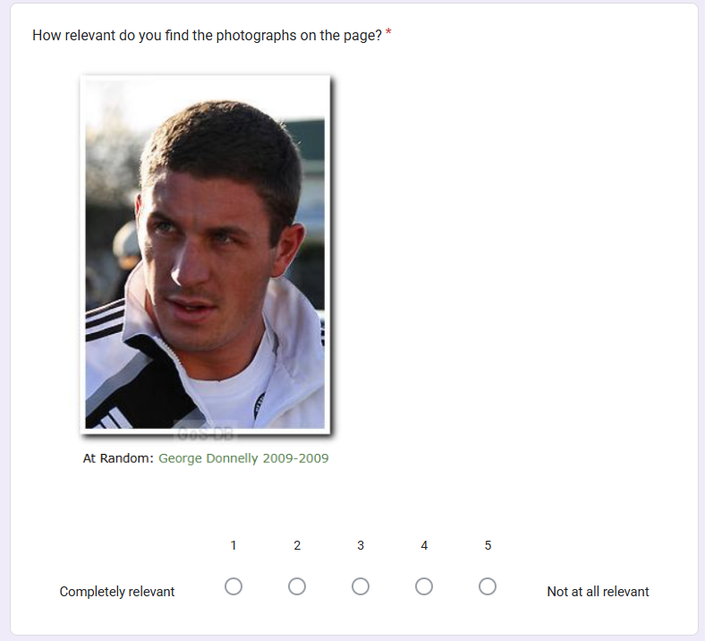
Greens on Screens Section 1: Survey

Slide 17
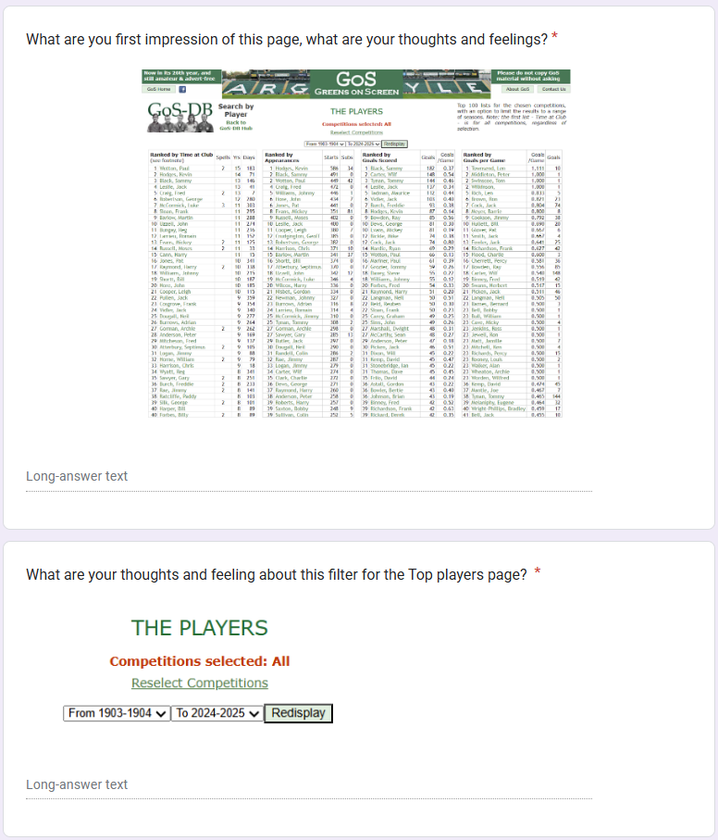
Greens on Screens Section 1: Survey

Slide 18
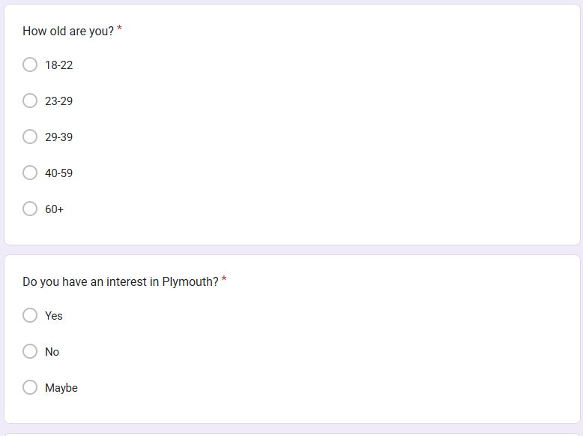
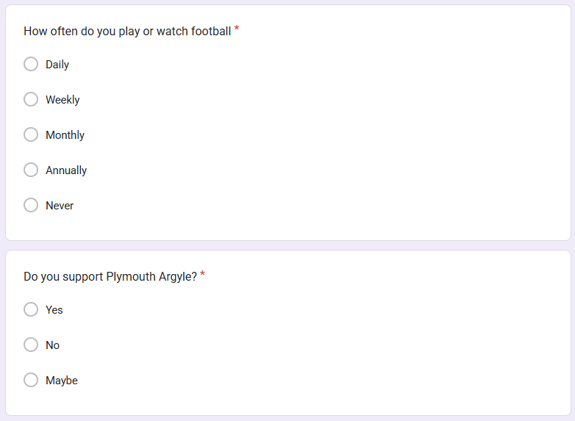
Greens on Screens Section 1: Survey

Slide 19
Greens on Screens Section 2: Participants
Anonymous survey questions
Participants were able to answer freely their opinions
Diversity of demographics
9 Participants within 18-22, 23-29 and 60+ age brackets
With relevant interests
Majority of participants had a key interest in Plymouth, football or Plymouth argyle
Potential Bias
Participants were known associates of the evaluator

Slide 20
Greens on Screens Section 2: Analysis
All pages are overwhelming
Home Described as “outdated, dull, busy, chaotic.”
5/9 users found the home layout difficult to understand.
Too much white space was described
About section Described as “stressful, ugly, overwhelming, confusing.”
Top Players page Described as “overwhelming, cluttered, stressful.” Player List Expectation
8/9 expected the "All Players" button to show a list of players.
All users thought the page wasted space.
Users expected more data in the table columns.
Navigation and title mismatch
Many participants found navigation misleading
Player search failure
4/9 users couldn’t find Phil Gee’s information, and 3 others struggled.
Filter Page issues
7/9 participants struggled to find them.
8/9 found the filter page poorly described.

Slide 21




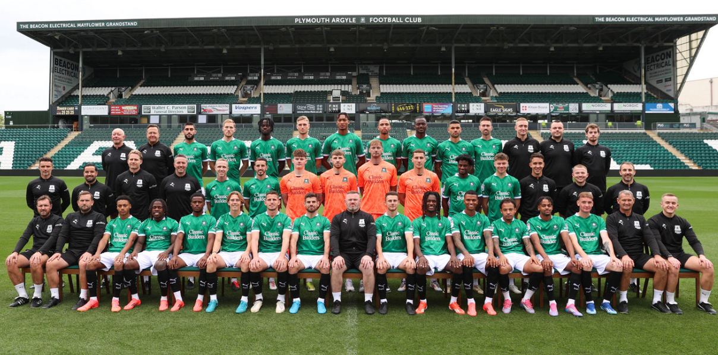
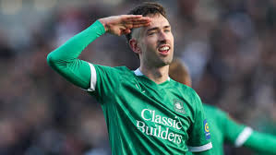
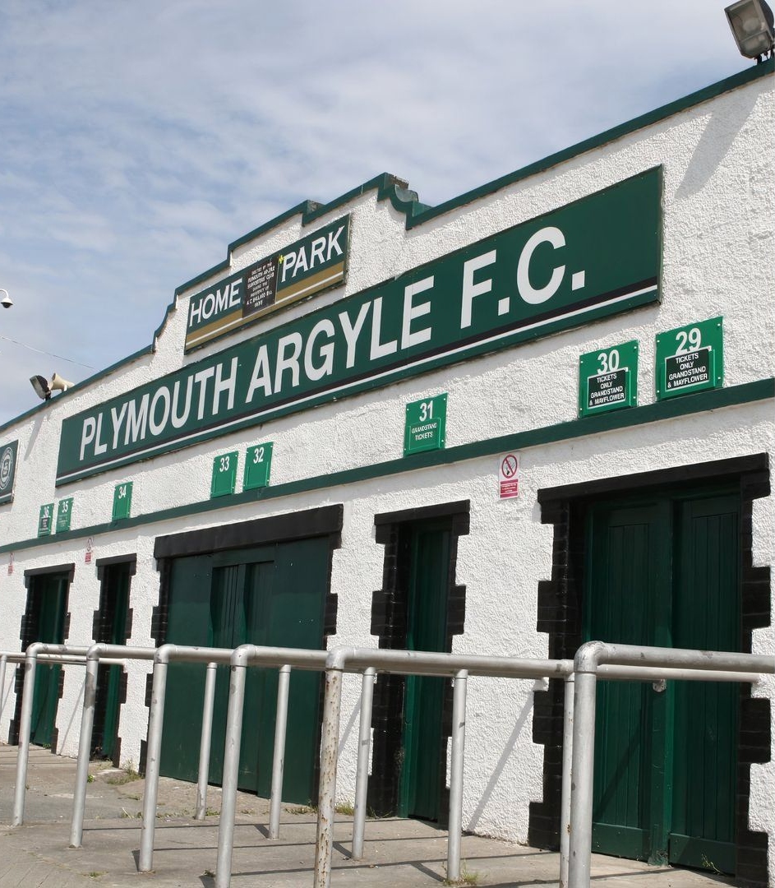
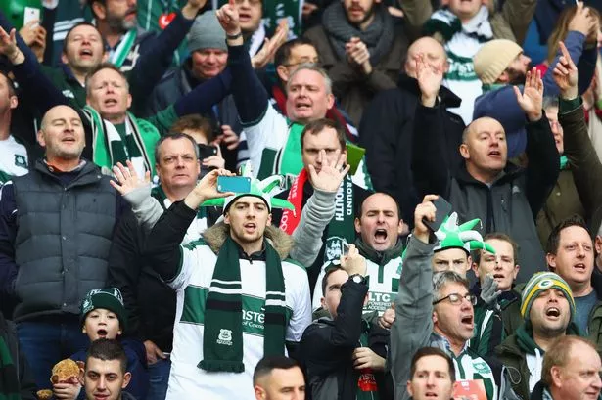
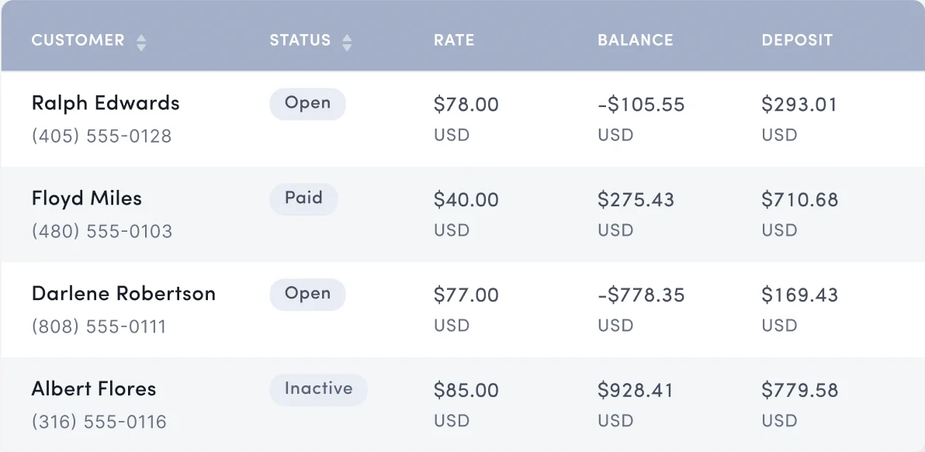
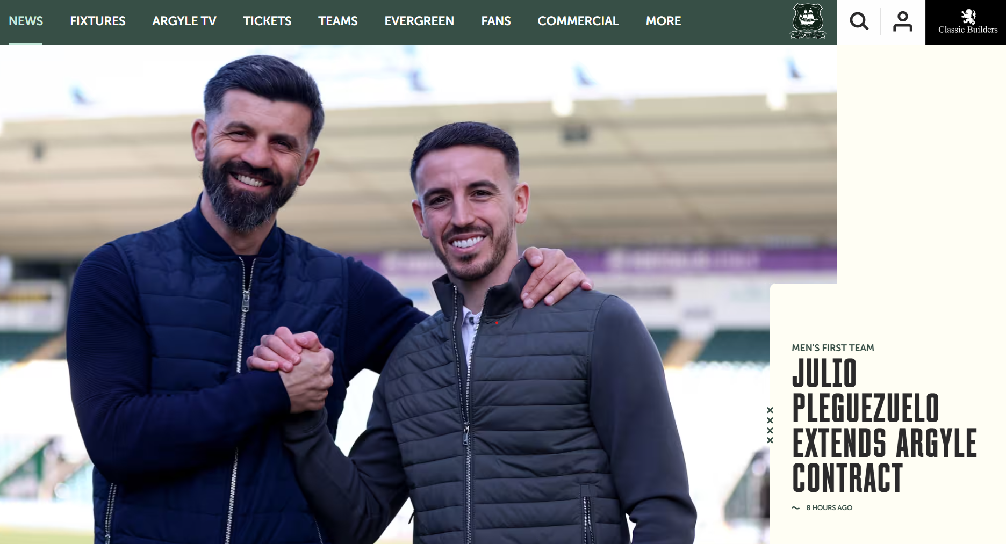

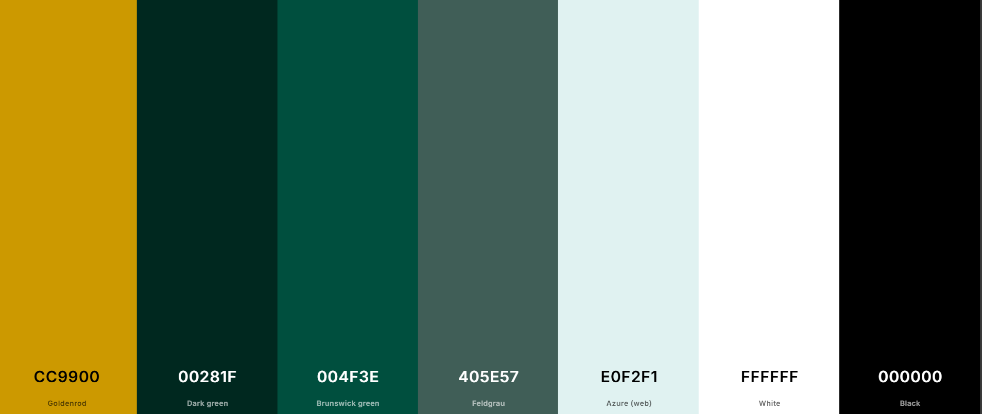
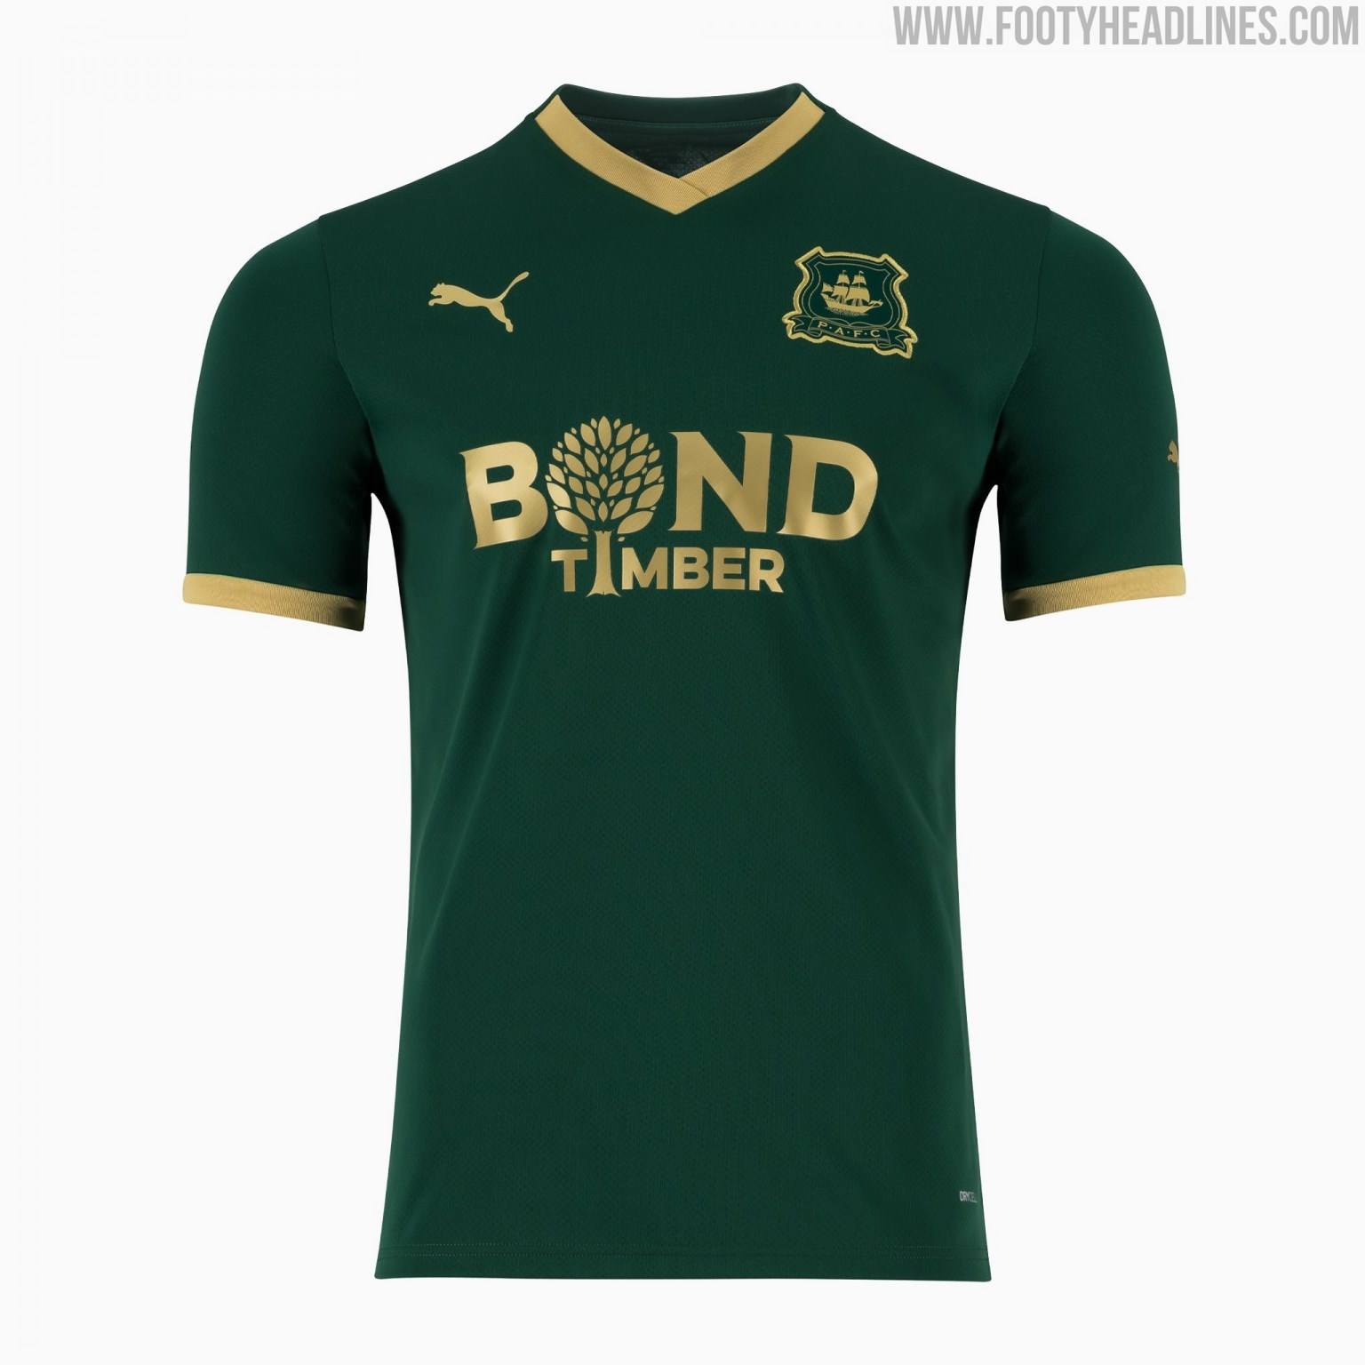
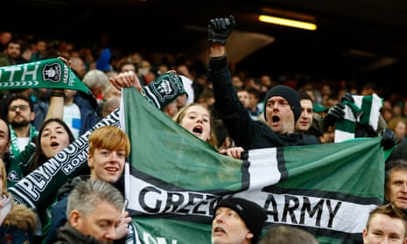
Greens on Screens
Greens on Screen
Season Match Player Manager
Greens on Screen
Season Match Player Manager

Slide 22
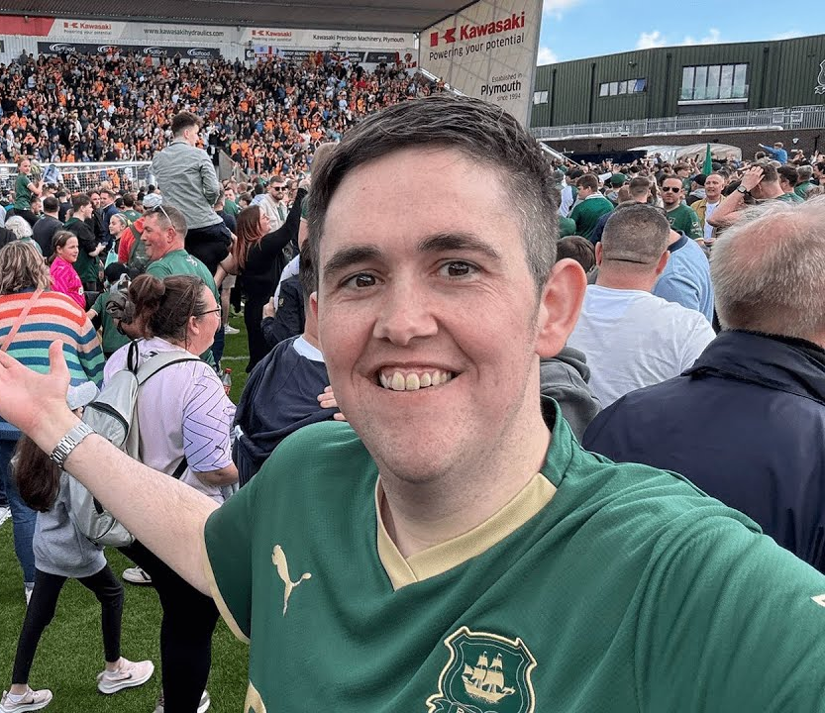
Greens on Screens Section 2: Personas
Jake Ableton
Age: 24
Occupation: Carpenter
Hobbies: Watching Plymouth argyle, playing FIFA, drinking beer
Purpose: Wants Plymouth stats and fan photos

Slide 23

Greens on Screens Section 2: Personas
Donald Hargreaves
Age: 56
Occupation: Philosophy Lecturer
Hobbies: History, Journalism and Politics
Purpose: Wants to uncover Plymouth Argyle affect on the local area’s development

Slide 24
Greens on Screens Section 3: Navigation issue
Before

Slide 25
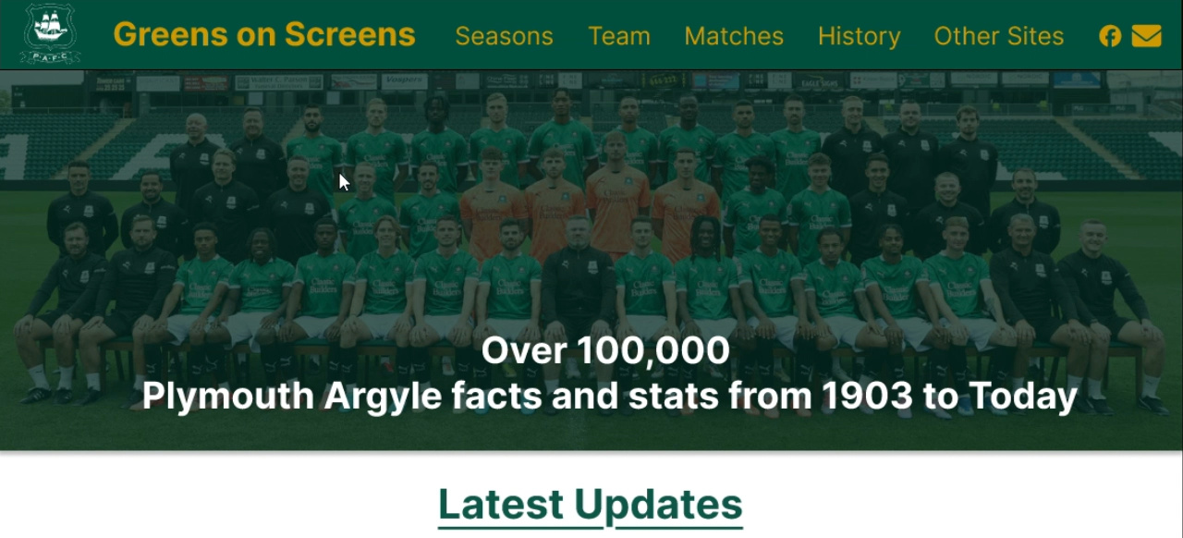
Greens on Screens Section 3: Navigation issue
After

Slide 26
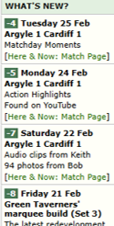
Greens on Screens Section 3: Latest updates
Before

Slide 27
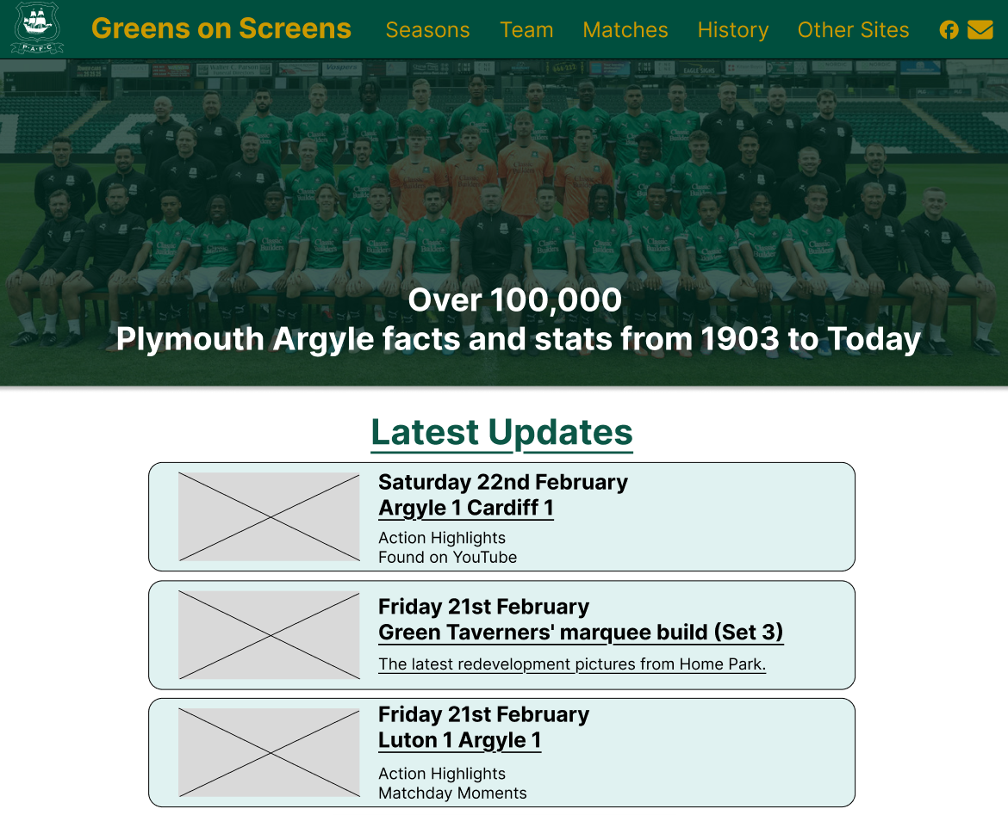
Greens on Screens Section 3: Latest updates
Contact us, simplified
Simplified logo
Website purpose made clear
Photos break up updates content
Latest updates displayed as primary feed
After
Top 3 Updates displayed

Slide 28
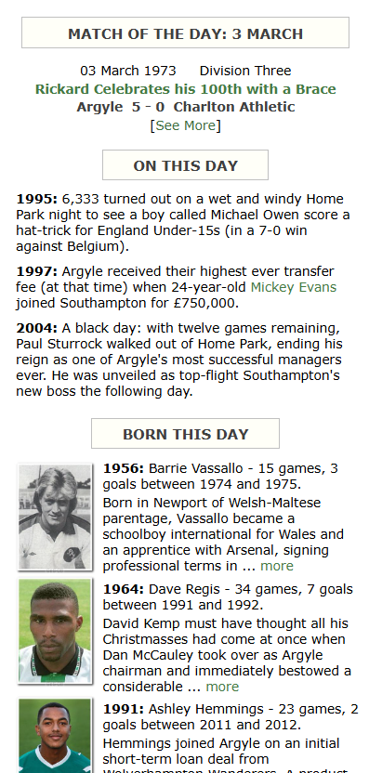
Greens on Screens Section 3: On this day
Before

Slide 29
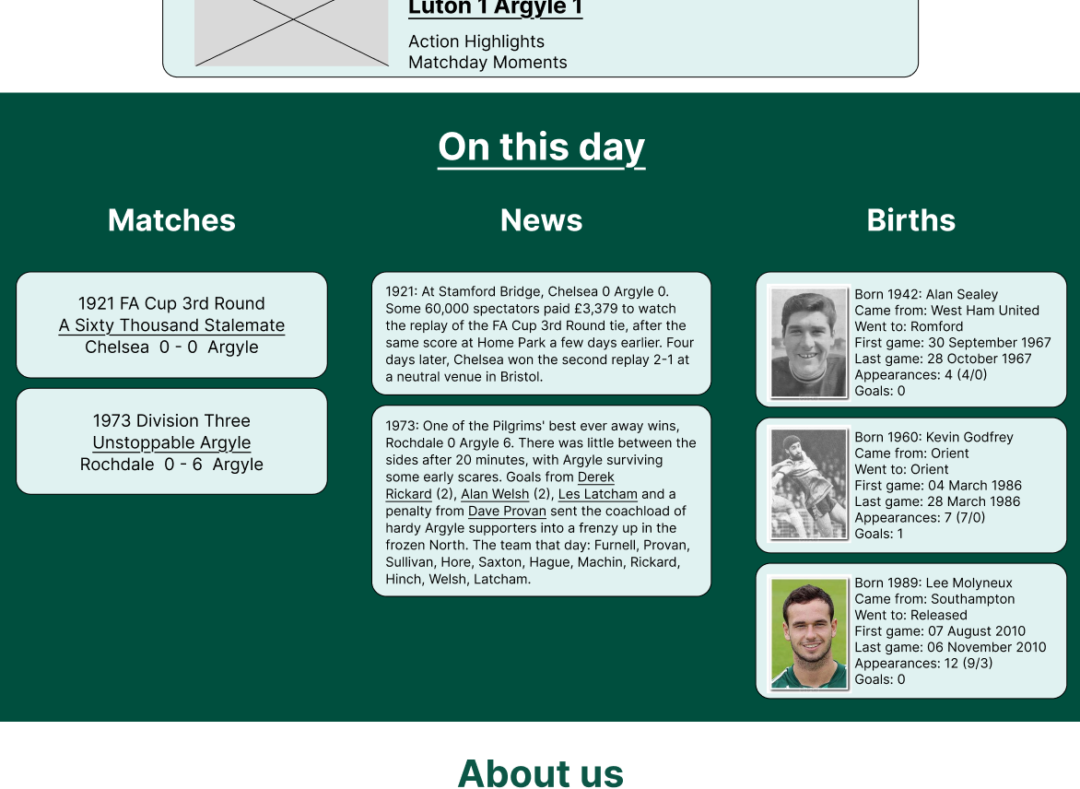
Greens on Screens Section 3: On this day
Container describes change in content
On this day sections separated by columns
Player stats used rather than partial biography
Cards used to separate feed items and make content more clickable
After

Slide 30
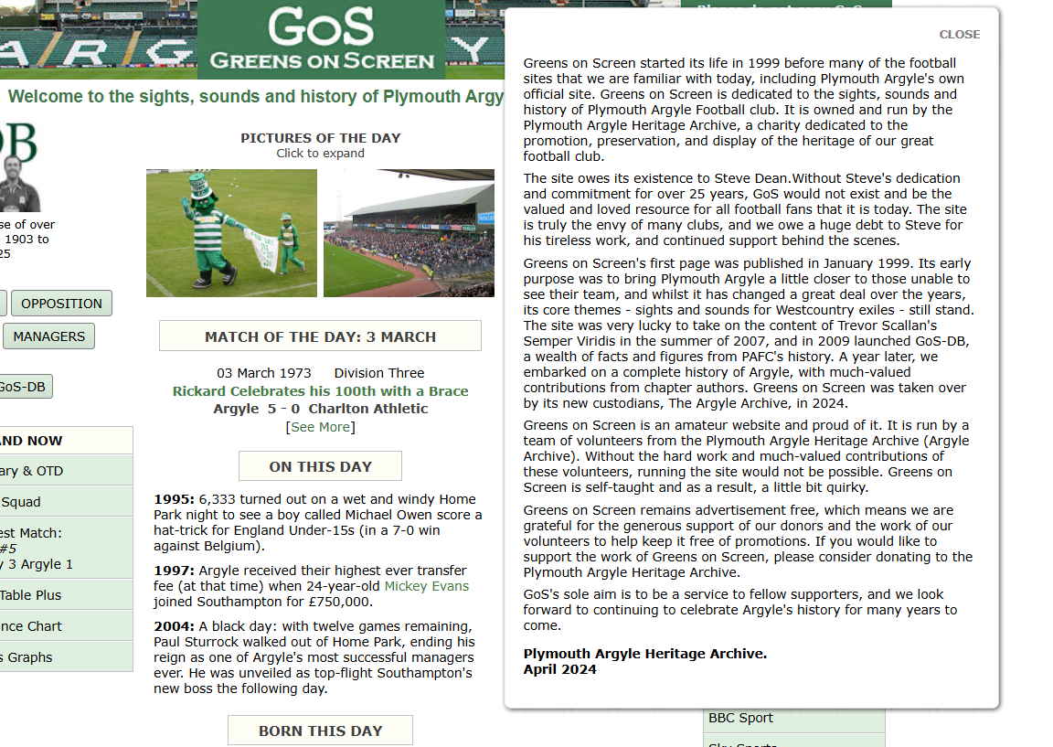
Greens on Screens Section 3: About Section

Slide 31
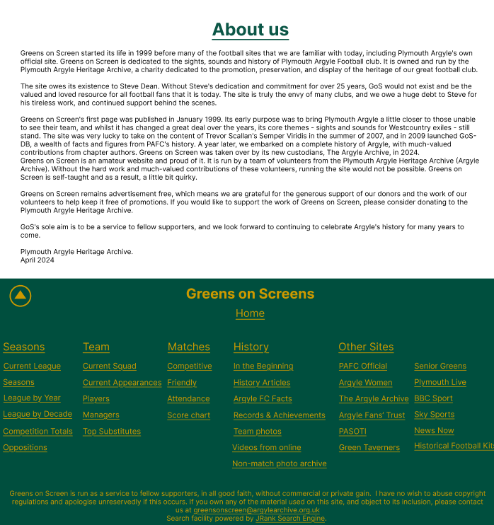
Greens on Screens Section 3: About Section
About us featured on homepage main content
Allows quick navigation to top of page
Fixed footers keep essential navigation more available, reducing the need for extra taps or scrolling.

Slide 32
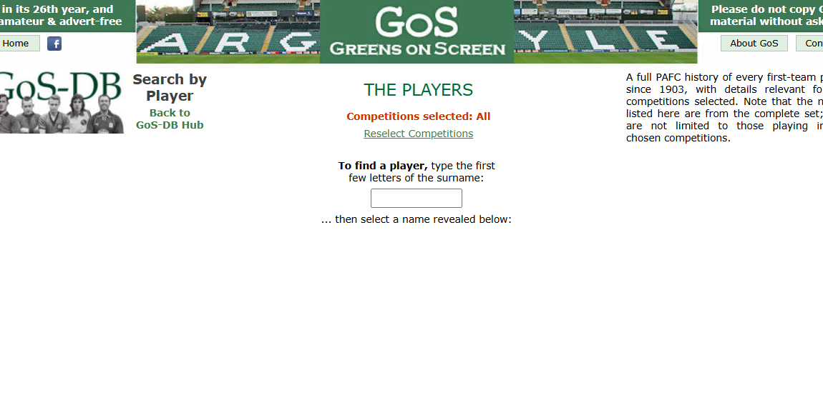
Greens on Screens Section 3: Player's search

Slide 33
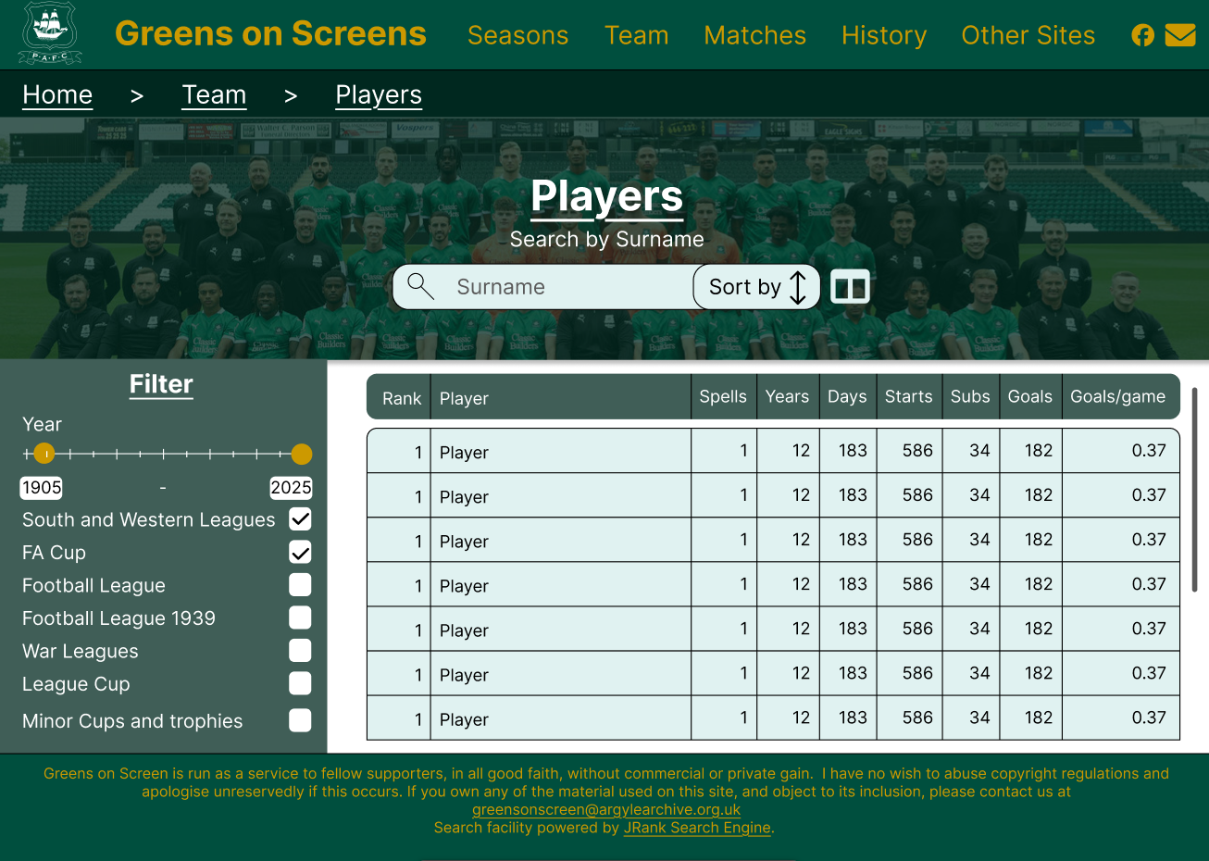
Greens on Screens Section 3: Player's search
Breadcrumbs make easy navigation
Curved boxes are more visually appealing
Users know to search by surname with label, icon and placeholder
Can describe scrollable table by lack of curved edge and scroll bar
Filtering options are on same page

Slide 34
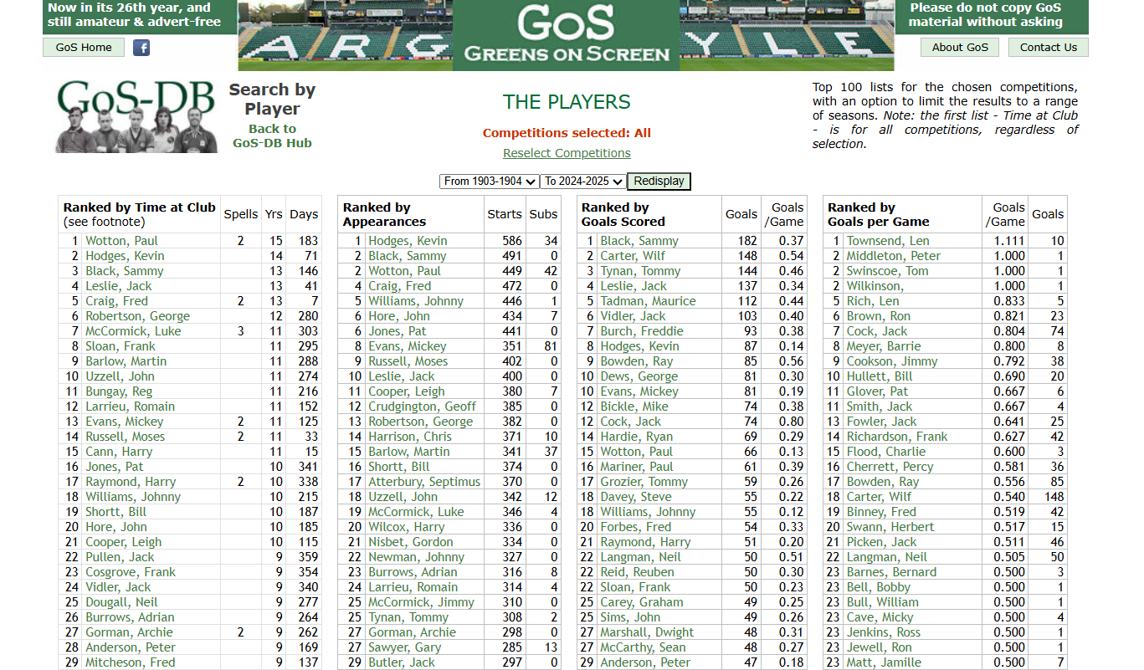
Greens on Screens Section 3: Top Players

Slide 35
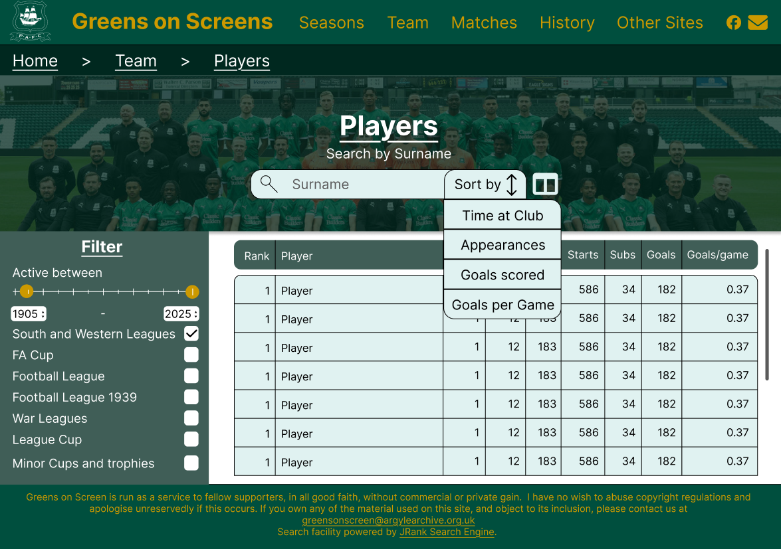
Greens on Screens Section 3: Top Players
Year filter by typing, slider or spinner controls
Can see Top players for a given statistic
Sticky table header

Slide 36
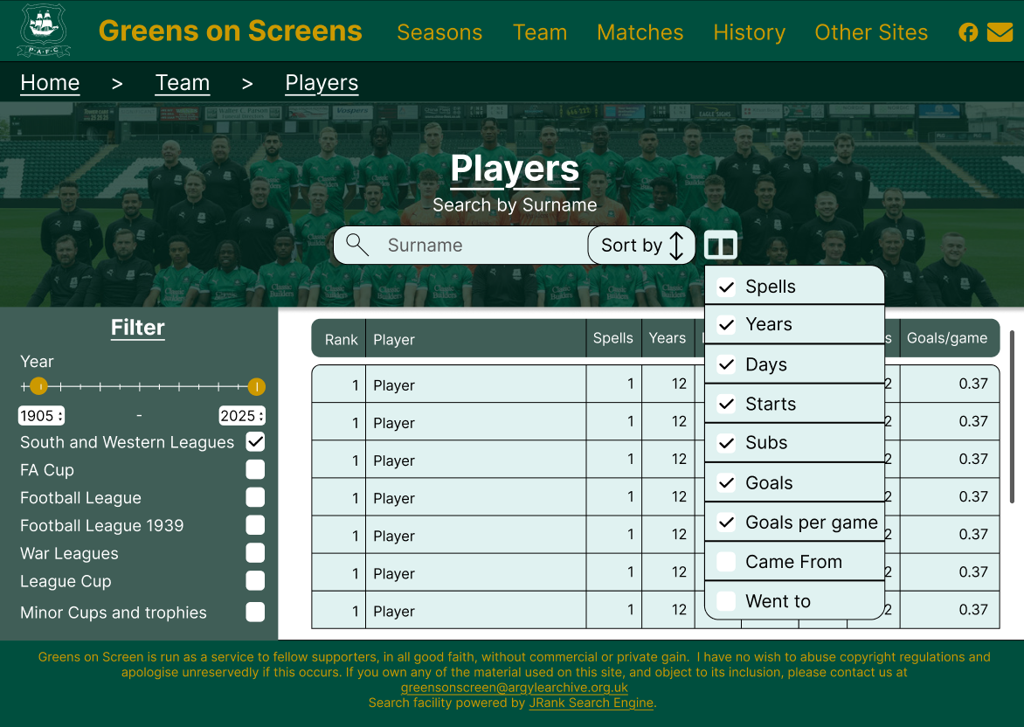
Greens on Screens Section 3: Columns
Can select and deselect columns for easier reading of table content

